Slide 1
Machine Learning Deployment Challenge
Apple

Slide 2
Creating the HTTP server
For creating the server, Flask microframework has been chosen since it comes with built-in light weight web servers.
A pretrained Kera model called ResNet50 has been chosen from the Keras pretrained deep learning model repository.
Some of the function signature of the server are given below.
def load_model(): This is to load the model.
def prepare_image(image, target): This is the method to preprocess the image before sending it to the model for analyzing and prediction.
def status(): This is to handle the GET requests.
def predict(): This is to handle the POST request for showing the prediction results after running the model against the given input image.
def catch_all(path): To handle any unexpected route that has not been defined in the server.
def handle_error(error): To handle any errors or exceptions that may arise during API calls.

Slide 3
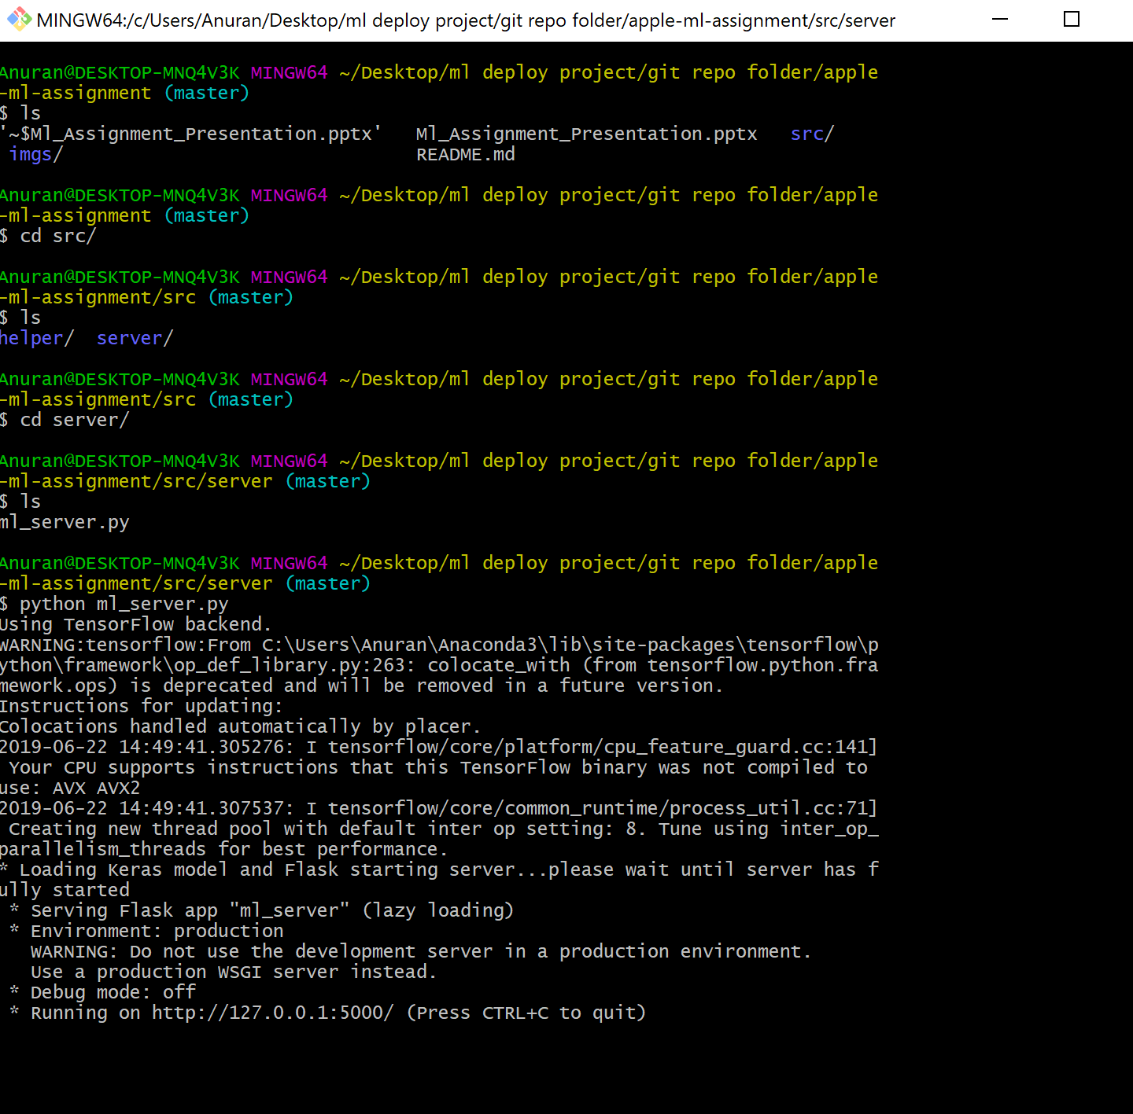
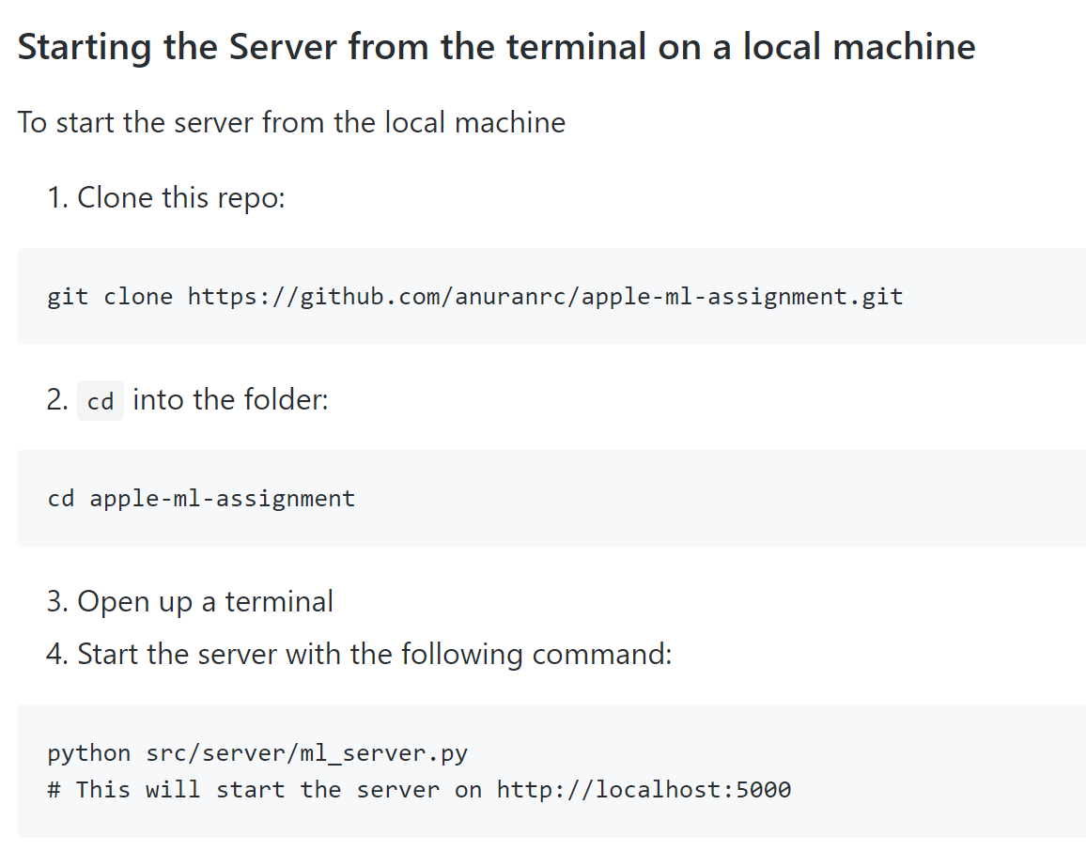
Running the Server
The running instructions and the snapshot of running the server from the local machine is given here

Slide 4
While Choosing the AMI Deep Learning Base AMI (Ubuntu) has been chosen since it is most fit for any Deep Learning or Machine Learning based Task.
For this assignment EC2 instance type is chosen as t2.micro since it is in the free tier and for general purpose computing (But for production work or computational intensive tasks there are other much powerful instances which can be chosen based on the task in hand).

Slide 5
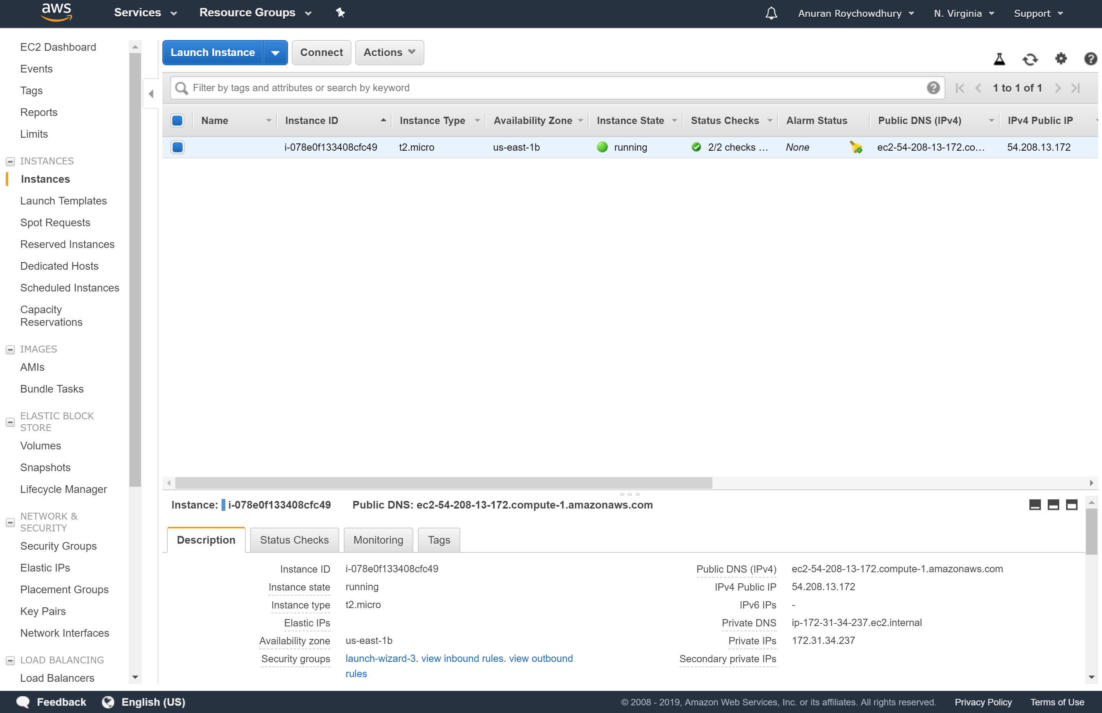
Snapshot of the running instance in the AWS EC2

Slide 6
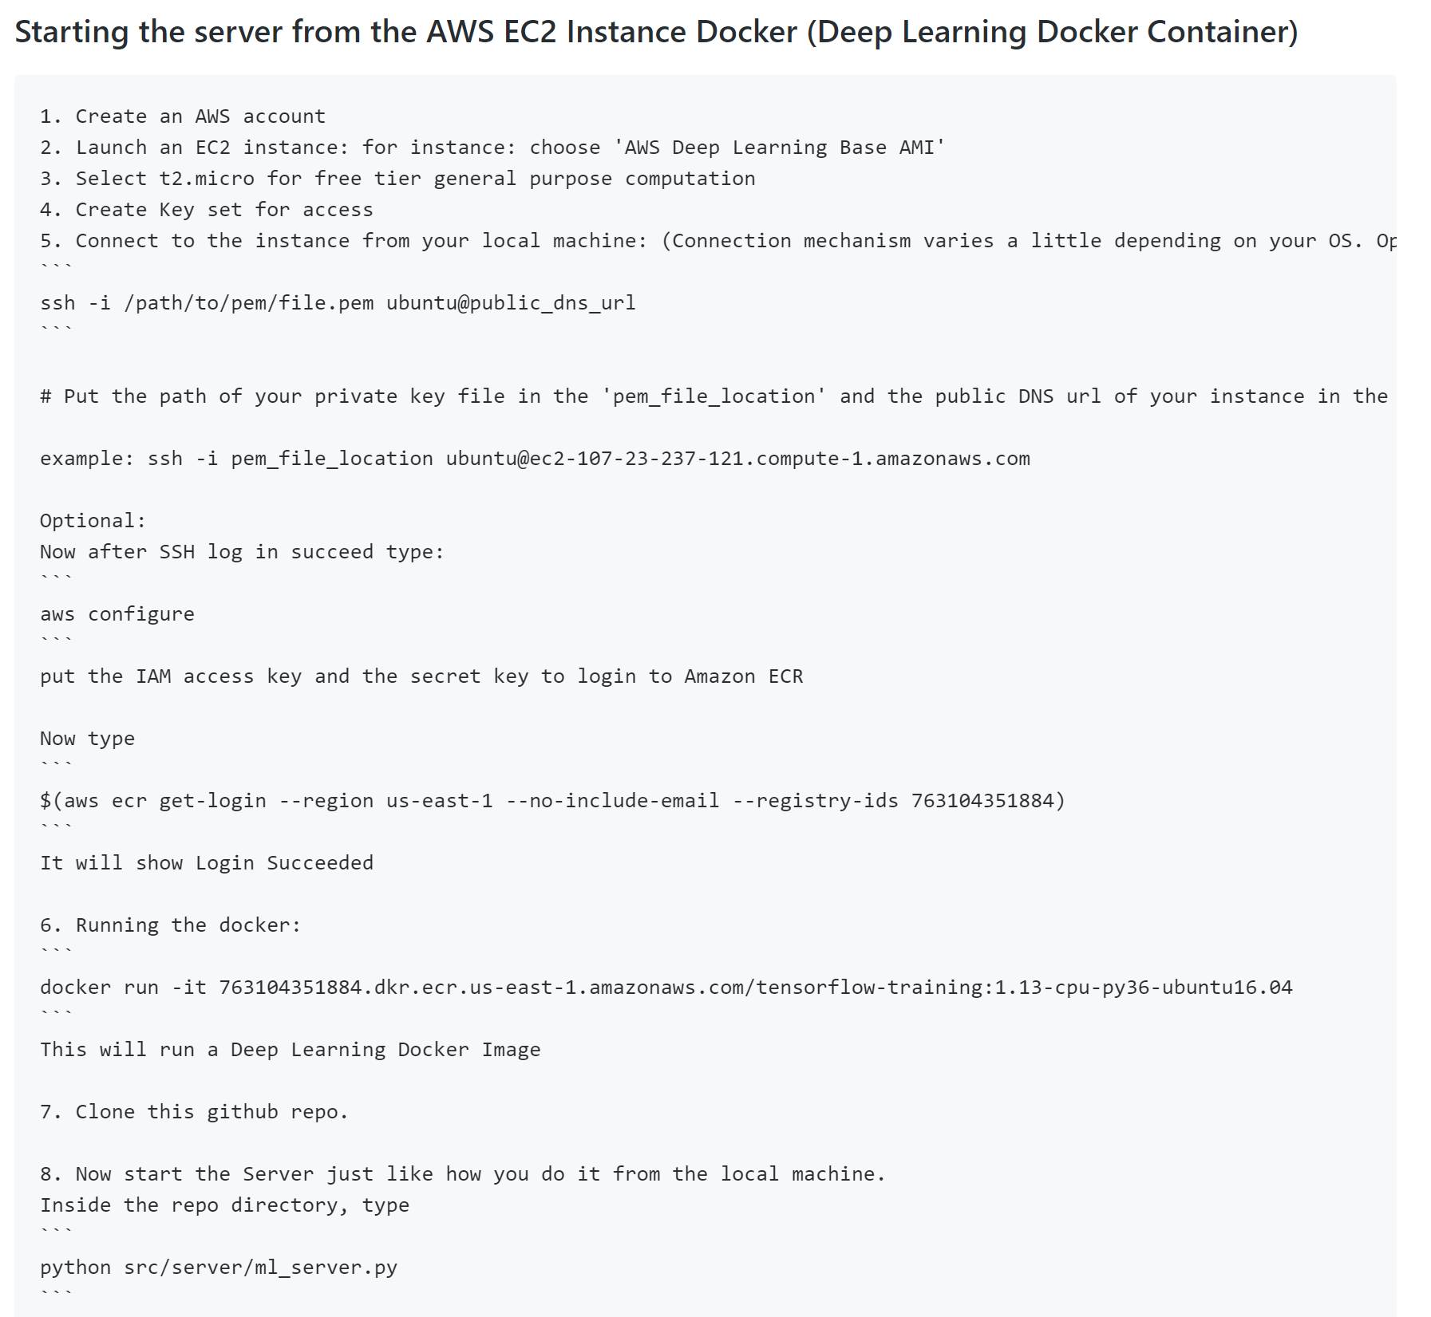
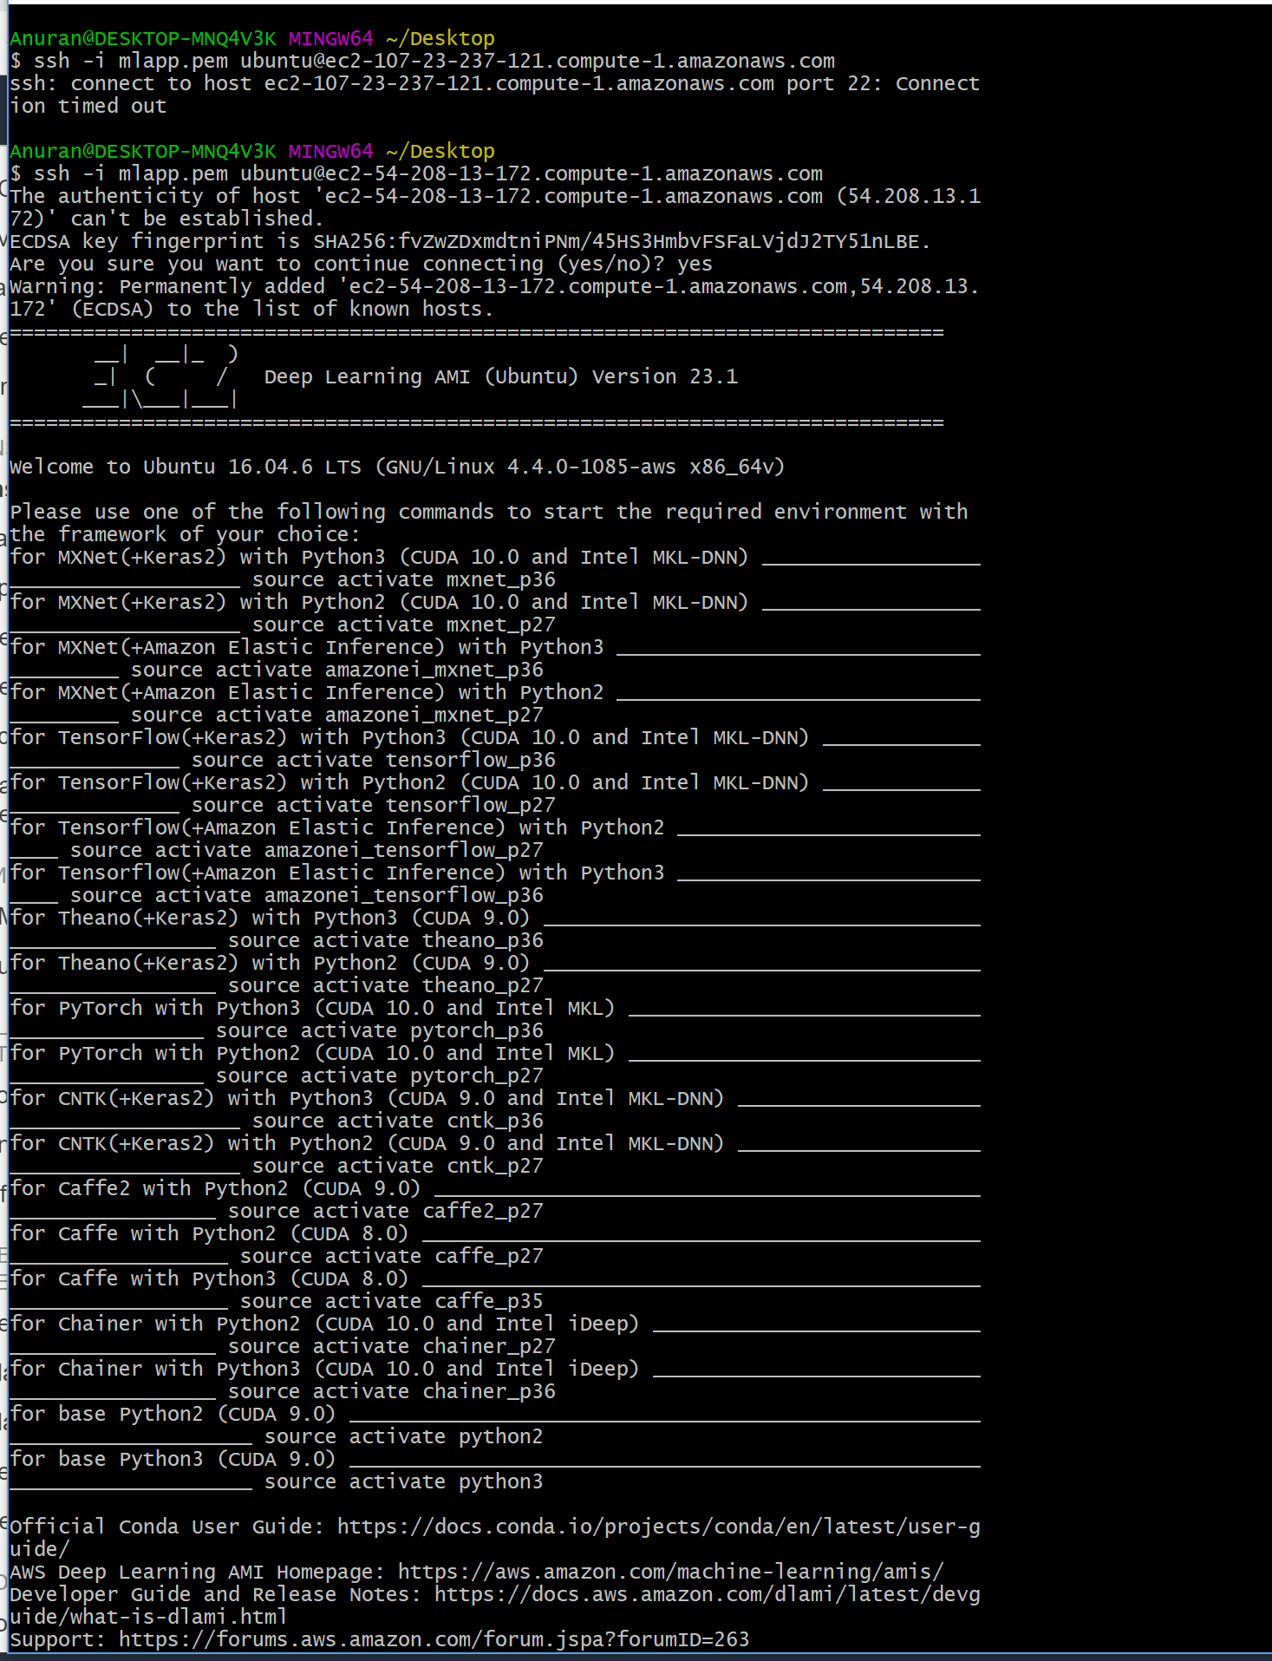
Sample Instructions for starting the server from the AWS EC2 Deep learning Docker container
SSH into the AWS EC2 instance

Slide 7
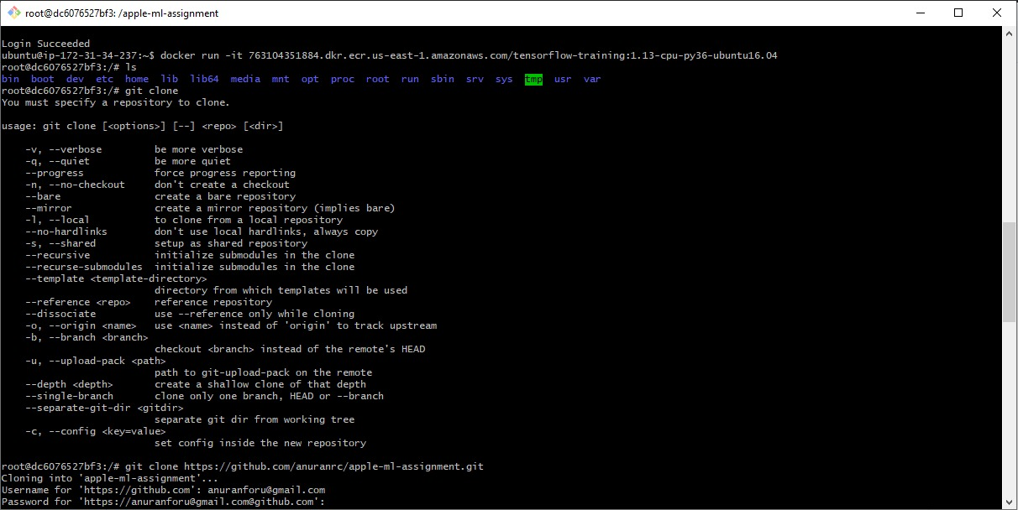
Initiating the Docker Container
AWS Deep Learning Container image has been chosen since it has all the necessary dependencies for running a Deep Learning application
Snapshot of the docker initiation and cloning the git repo

Slide 8
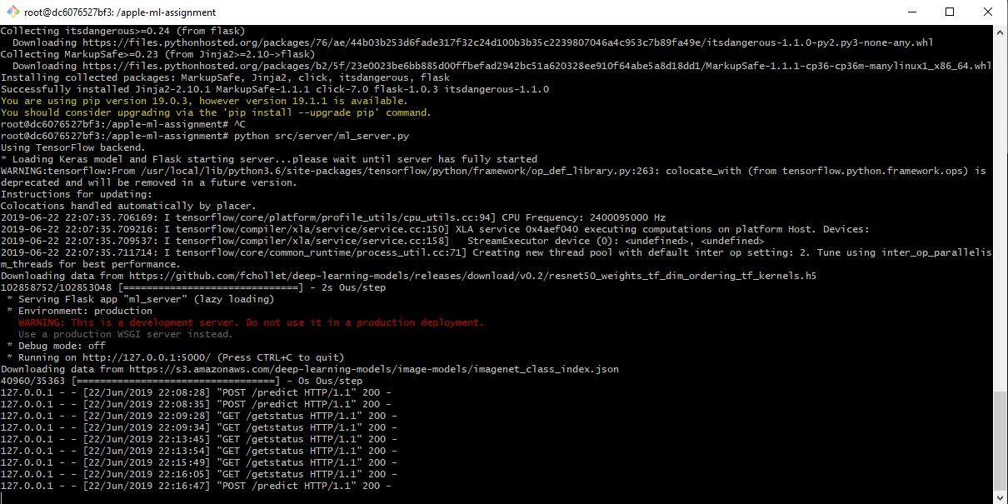
Snapshot of running server from the AWS EC2 deep Learning Docker container

Slide 9
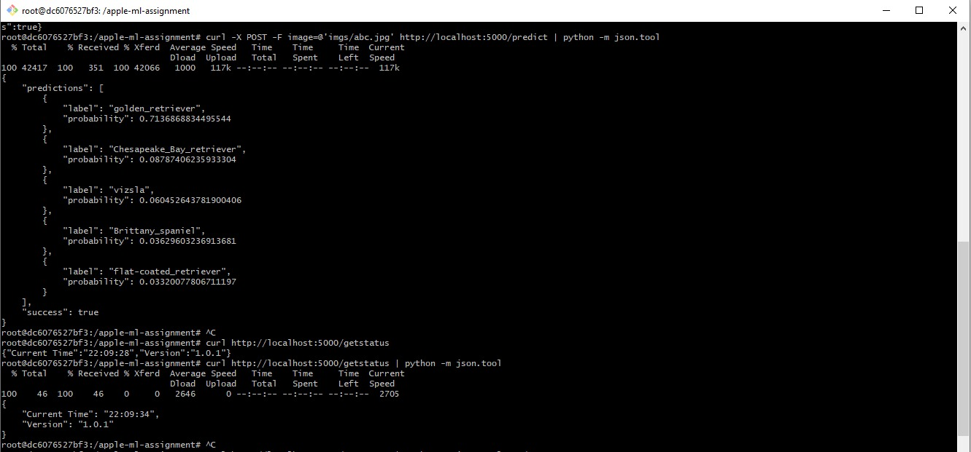
Response and Prediction Results
Results or Prediction outcomes from the models after running it with an image of a dog (The dog in the image is a golden retriever and the model predicted that with 0.71 probability)
Snap Shot of the responses of the /predict request

Slide 10
Thanks for the challenge!
I thoroughly enjoyed while implementing the task.

